Slide 1
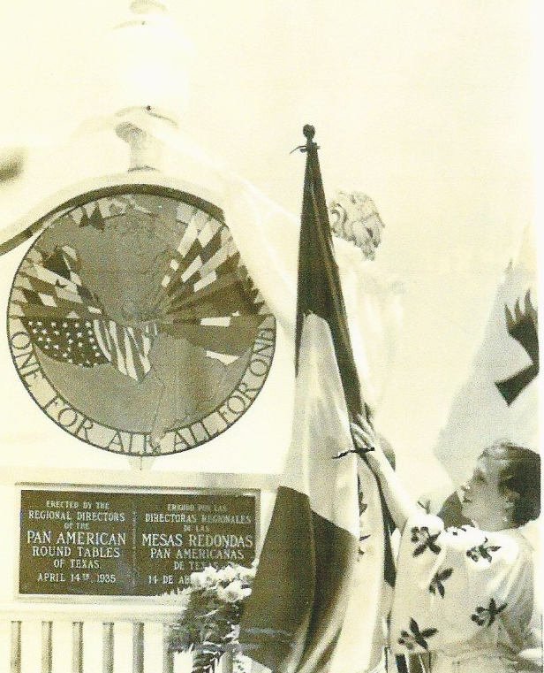
A MOMENT IN HISTORY

Slide 2
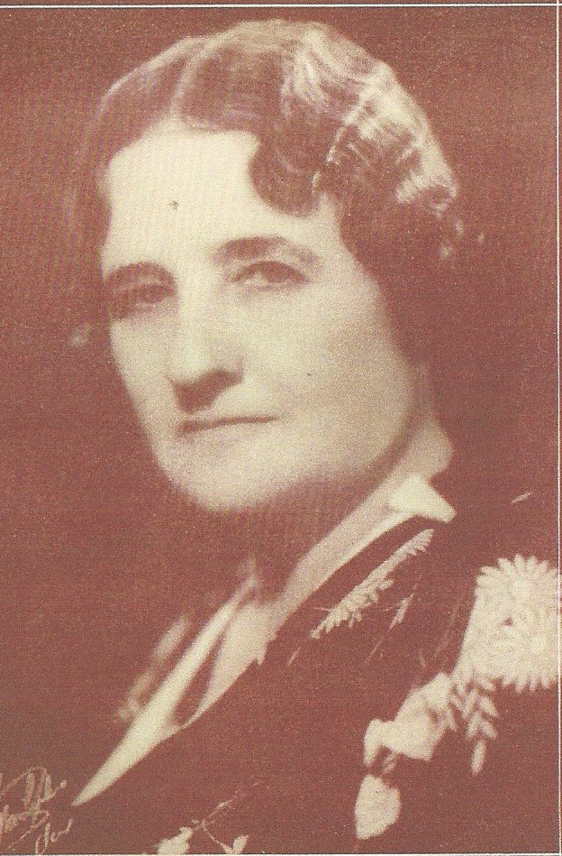
FLORENCE TERRY GRISWOLD

Slide 3
ON JUNE 16, 1934
MRS GRISWOLD RECEIVES A TELEGRAM FROM AMERICAN BOUNDARY COMMISSIONER THAT BOTH SECRETARIES OF STATE HAD GIVEN APPROVAL

Slide 4
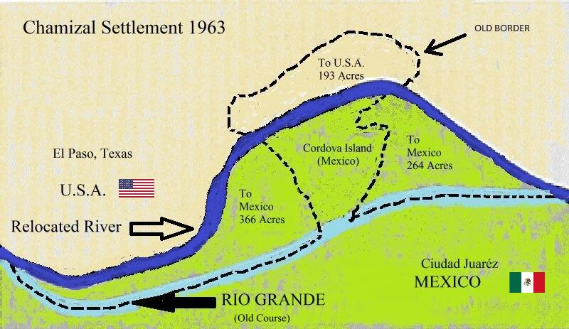

Slide 5
APRIL 14, 1935
PAN AMERICA OBSERVANCE DAY
THE DAY BEFORE THE PARTT CONVENTION IN LAREDO

Slide 6
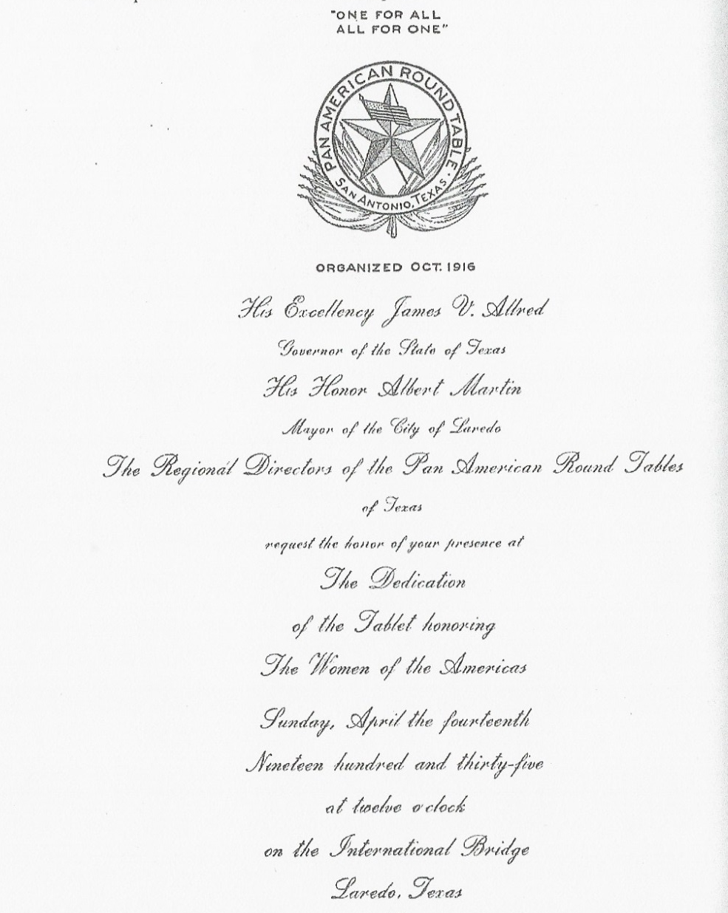
ENGRAVED INVITATION

Slide 7
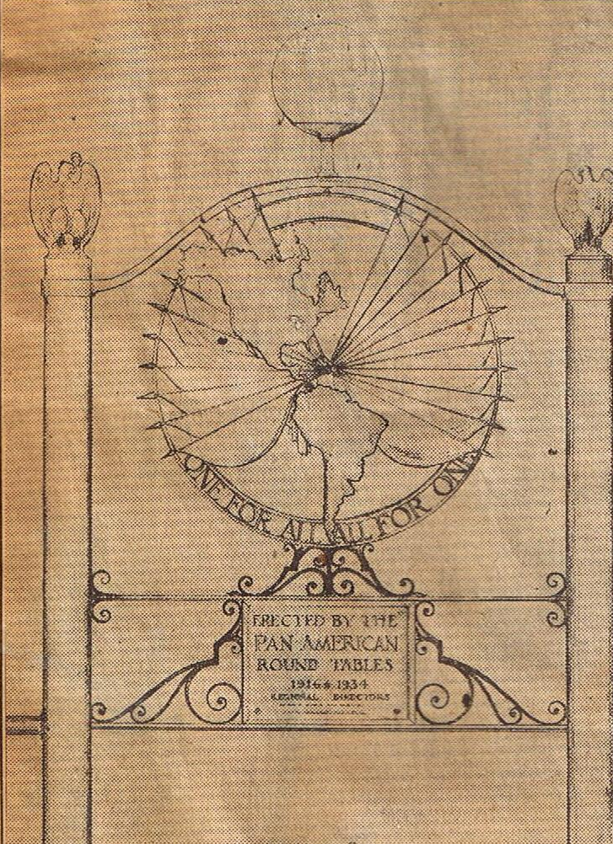
SKETCH AND BLUE PRINTS
BY HENRY WEDEMEYER

Slide 8
HAD TO MEET REGULATION OF INTERNATIONAL BOUNDARY COMMISSION: NORTH SIDE WRITTEN IN ENGLISH AND SOUTH SIDE WRITTEN IN SPANISH

Slide 9
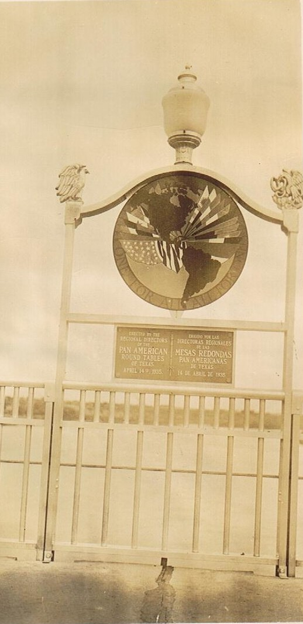

Slide 10
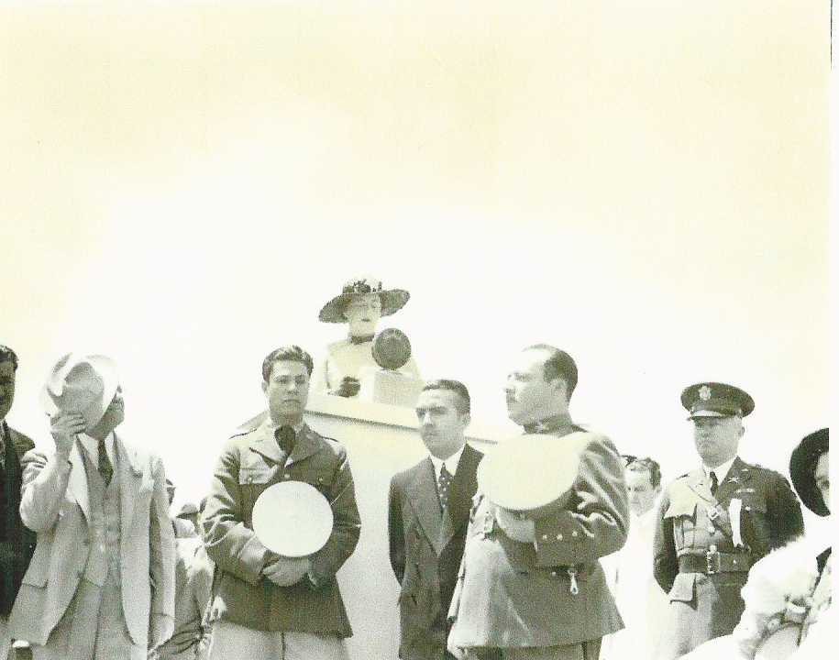
MISTRESS OF CEREMONIES
MRS. ALBERT MARTIN
PARTT STATE DIRECTOR

Slide 11
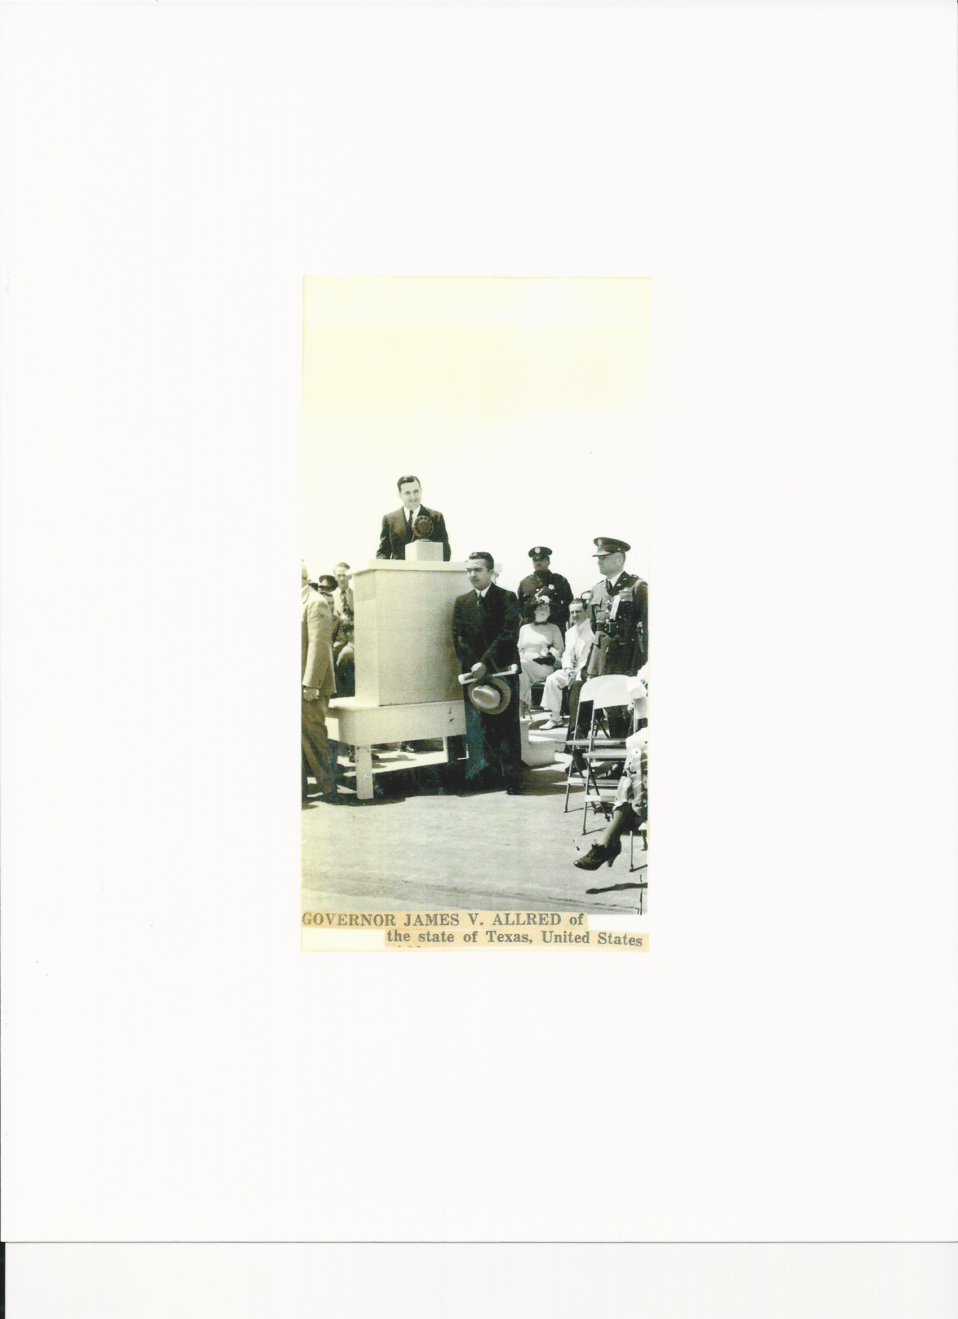
GOVERNOR JAMES V. ALFRED
STATE OF TEXAS

Slide 12
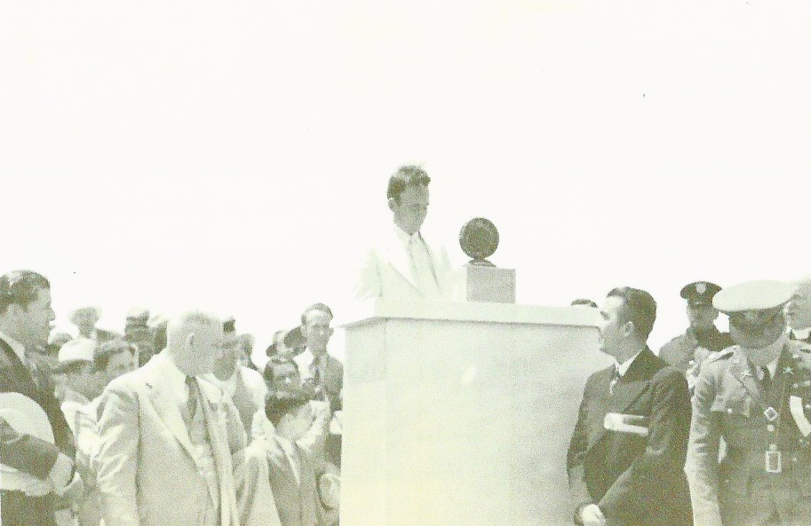
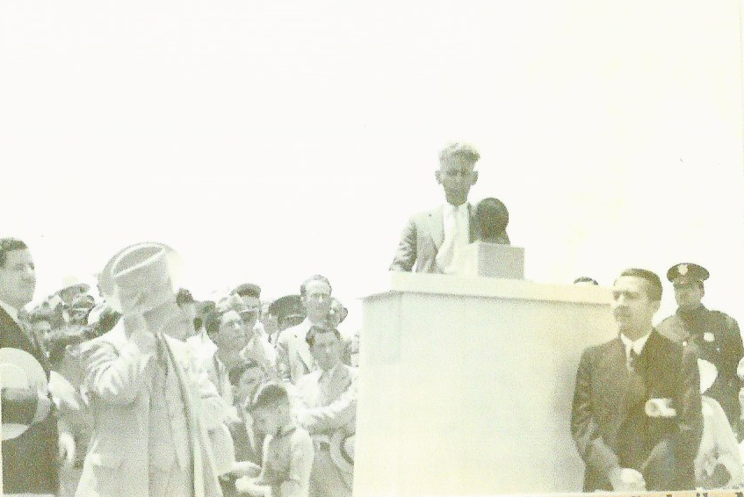
GOVERNORS OF TWO MEXICAN STATES
GOVERNOR PABLO QUIROGA
NUEVO LEON, MEXICO
JESUS VALDES SANCHEZ
GOVERNOR OF COAHULA, MEXICO

Slide 13
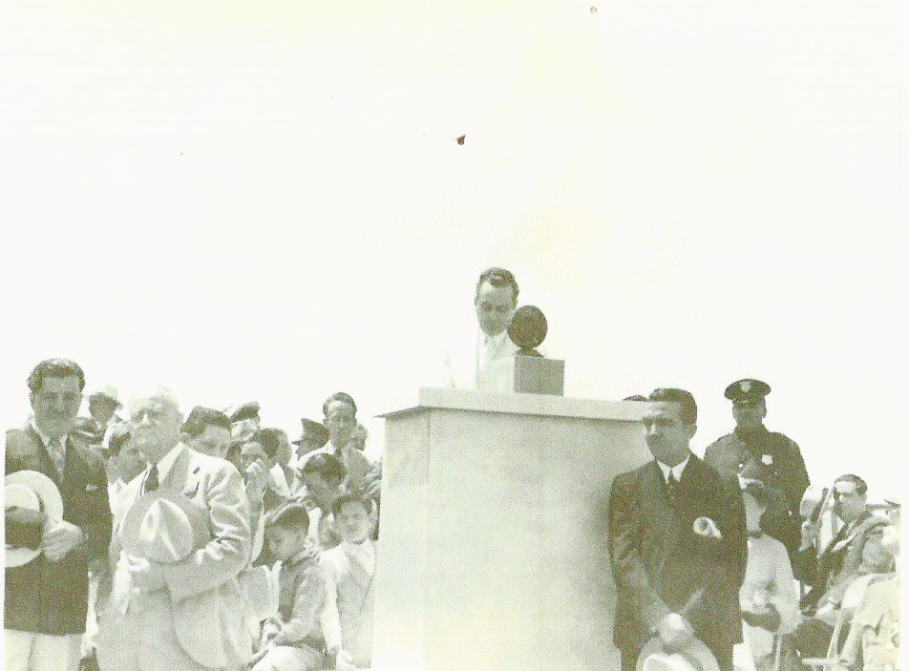
WELCOME BY MAYOR
ALBERT MARTIN

Slide 14
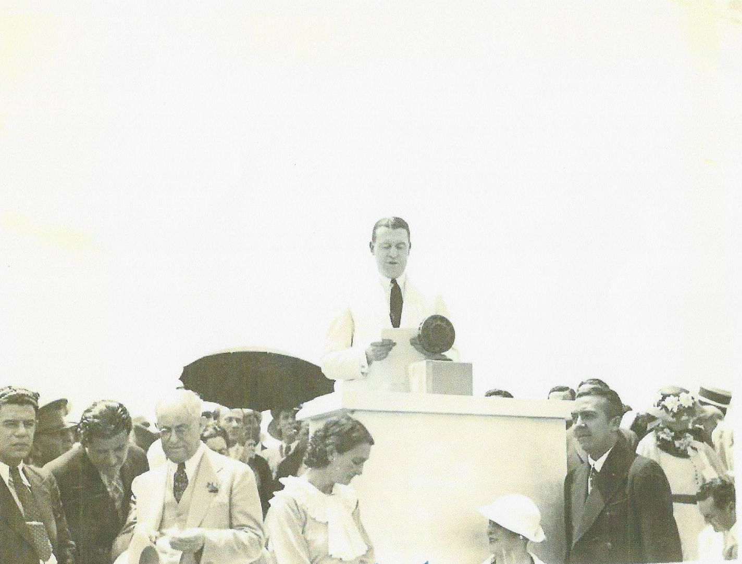
DEDICATORY ADDRESS
GIVEN BY EDWARD L. REED

Slide 15
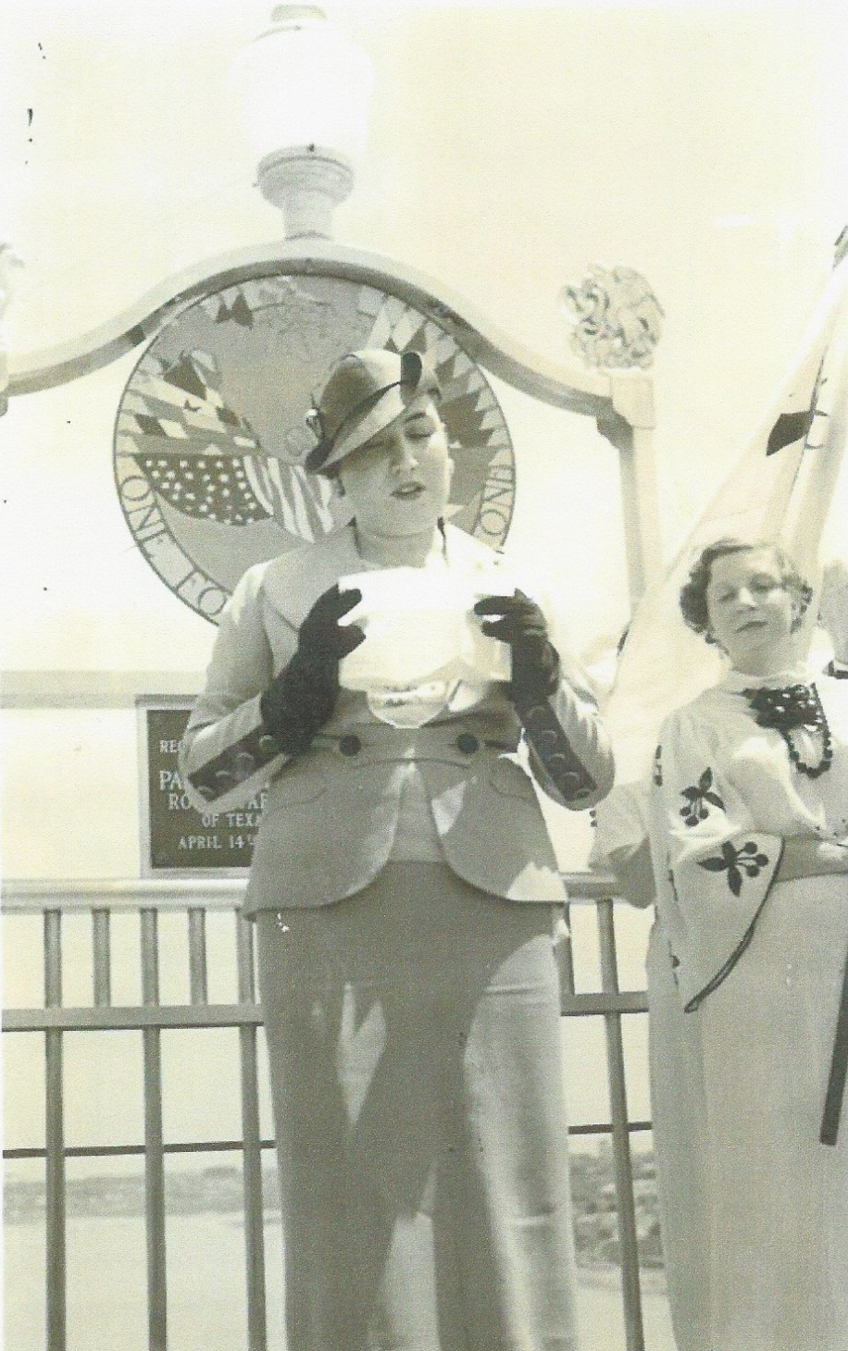
THE TABLET ON THE
LAREDO INTERNATIONAL BRIDGE WAS UNVEILED BY MRS. FERNANDO TORREBLANCO

Slide 16
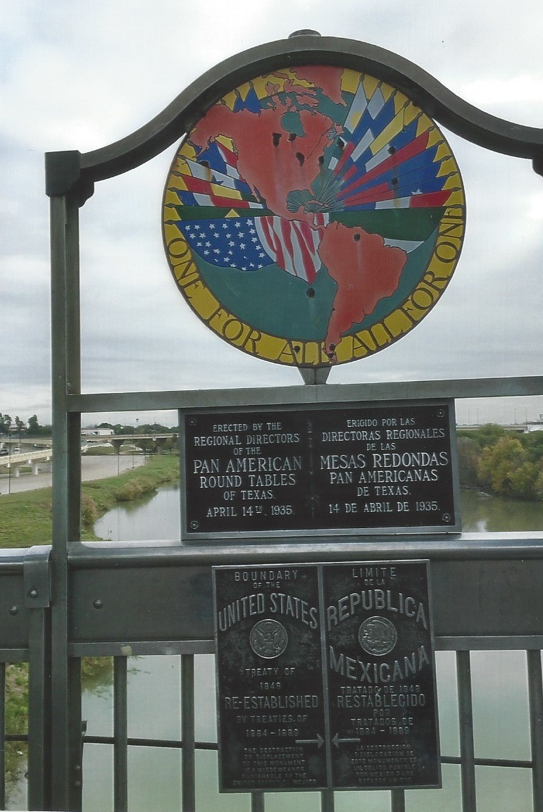

Slide 17
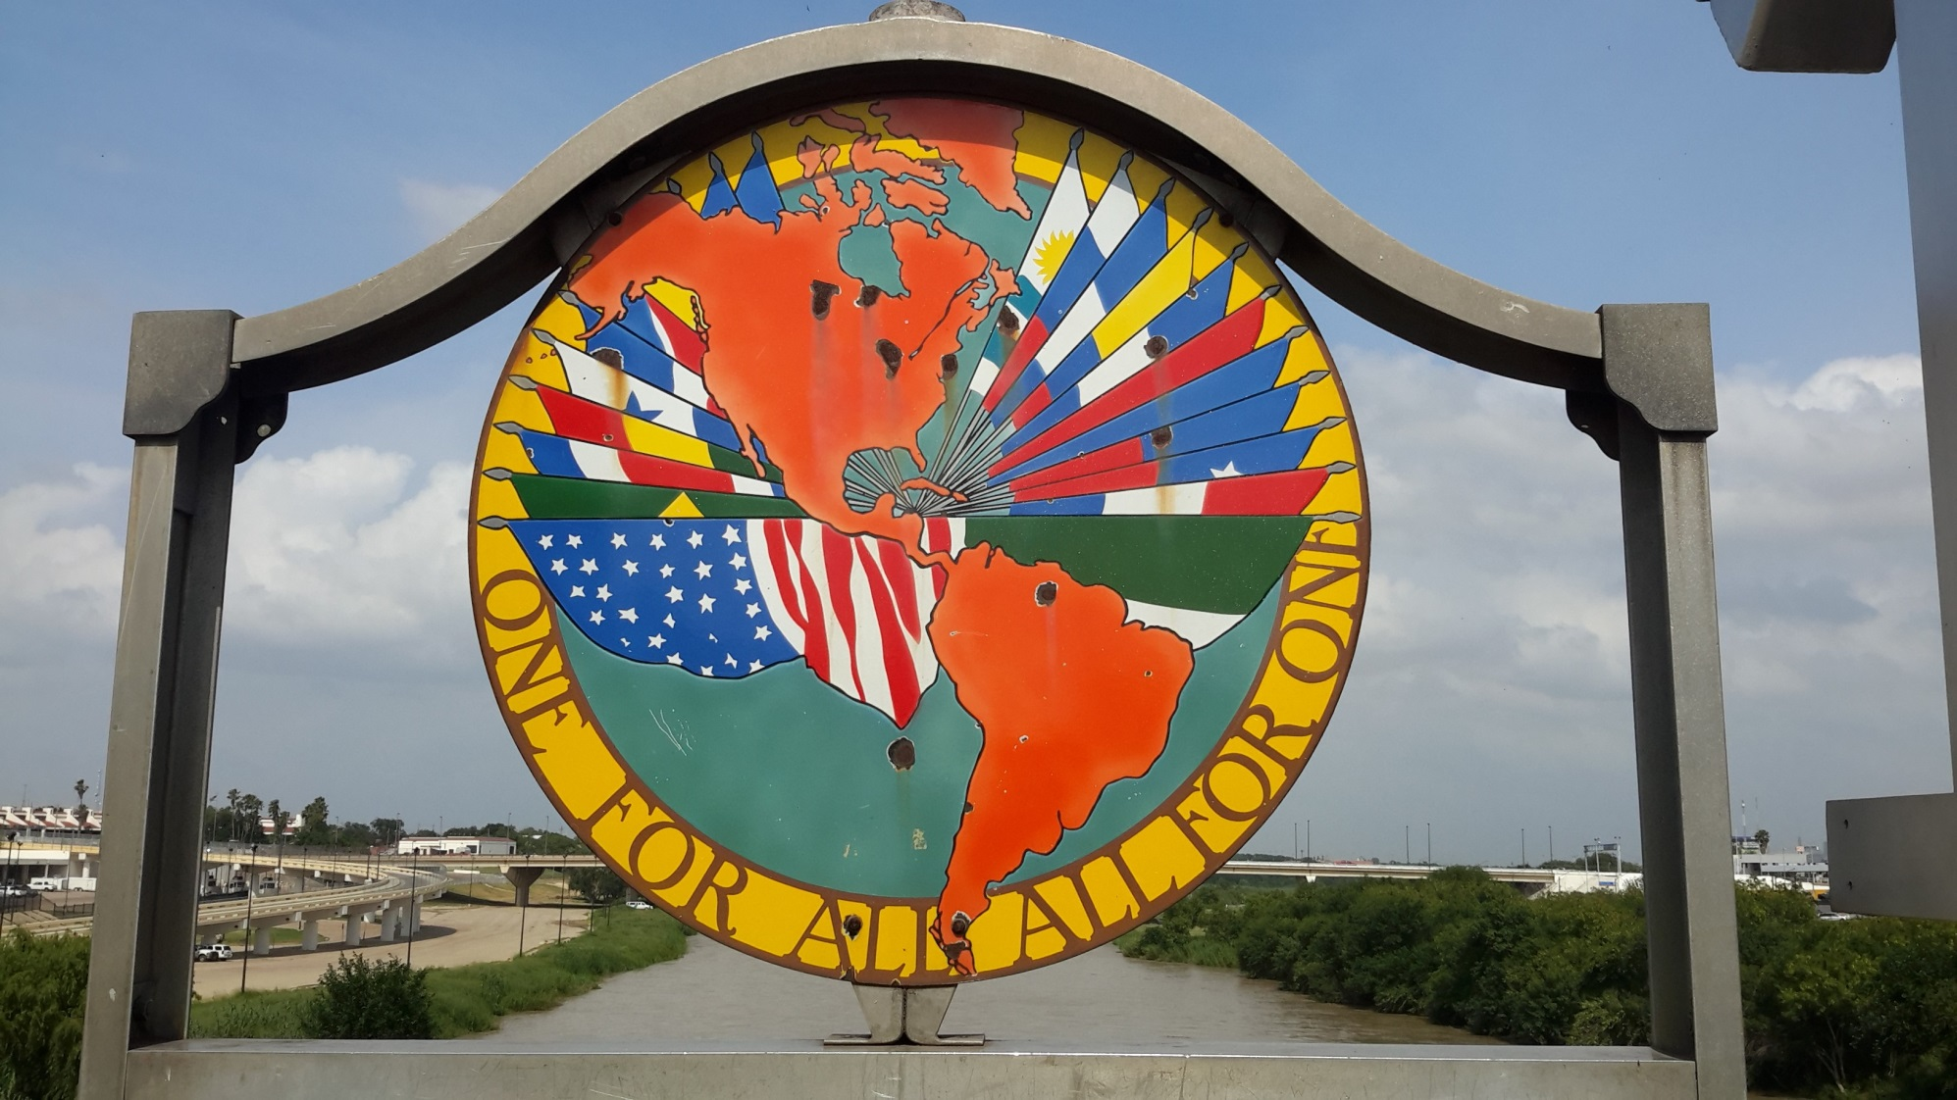

Slide 18
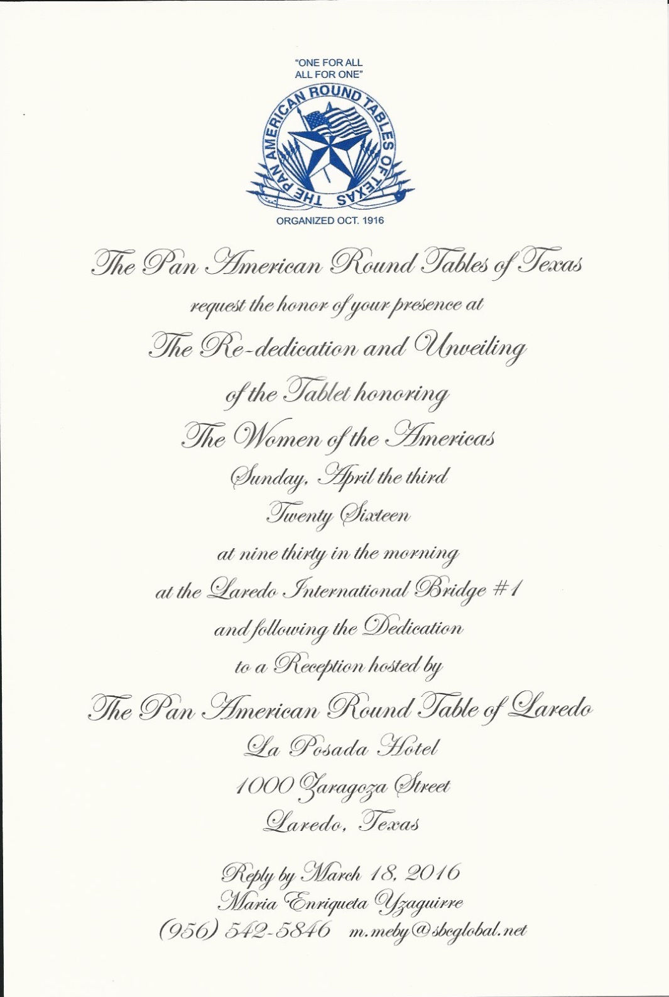

Slide 19
MISTRESS OF CEREMONY
DIANA C. RODRIGUEZ
PART OF LAREDO DIRECTOR

Slide 20
GUEST SPEAKER
CARLOS CASCOS
SECRETARY OF STATE
TEXAS

Slide 21
THE AIM OF THE PAN AMERICAN ROUND TABLE
MOVEMENT
TO PROVIDE MUTUAL KNOWLEDGE, UNDERSTANDING, AND FRIENDSHIP AMONG THE WOMEN OF THE WESTERN HEMISPHERE

Slide 22
AND TO FOSTER ALL MOVEMENTS LEADING TO A HIGHER CIVILIZATION, ESPECIALLY THOSE AFFECTING THE WOMEN AND CHILDREN OF THESE COUNTRIES.

Slide 23
“ONE FOR ALL
AND ALL FOR ONE”
“UNA PARA TODAS
Y TODAS PARA UNA”

